Slide 1
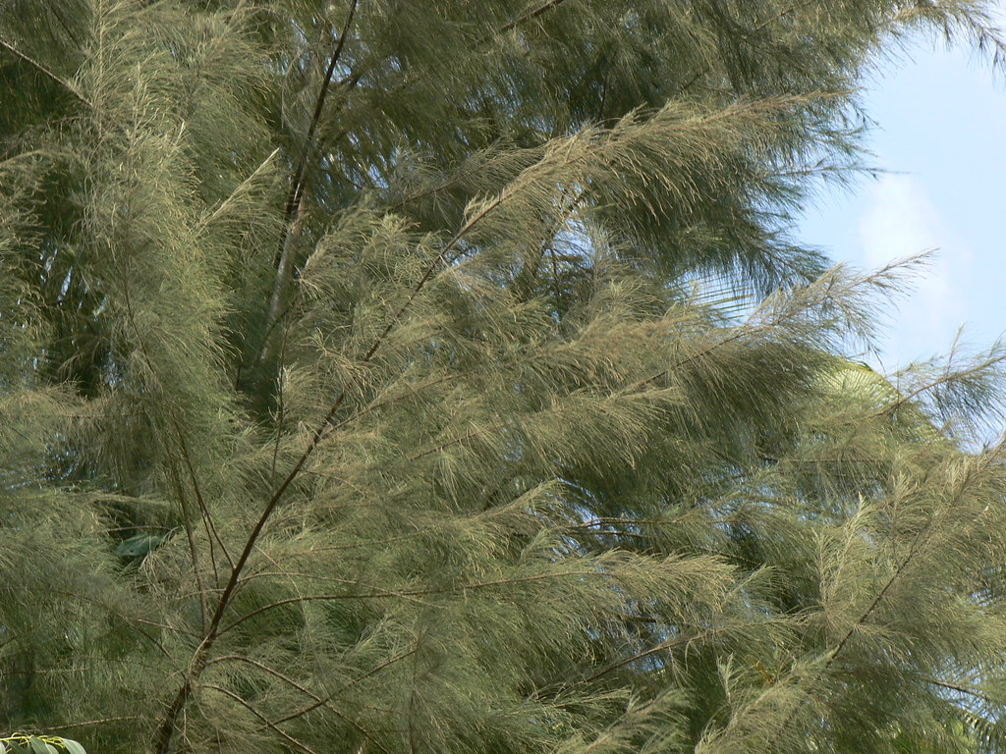
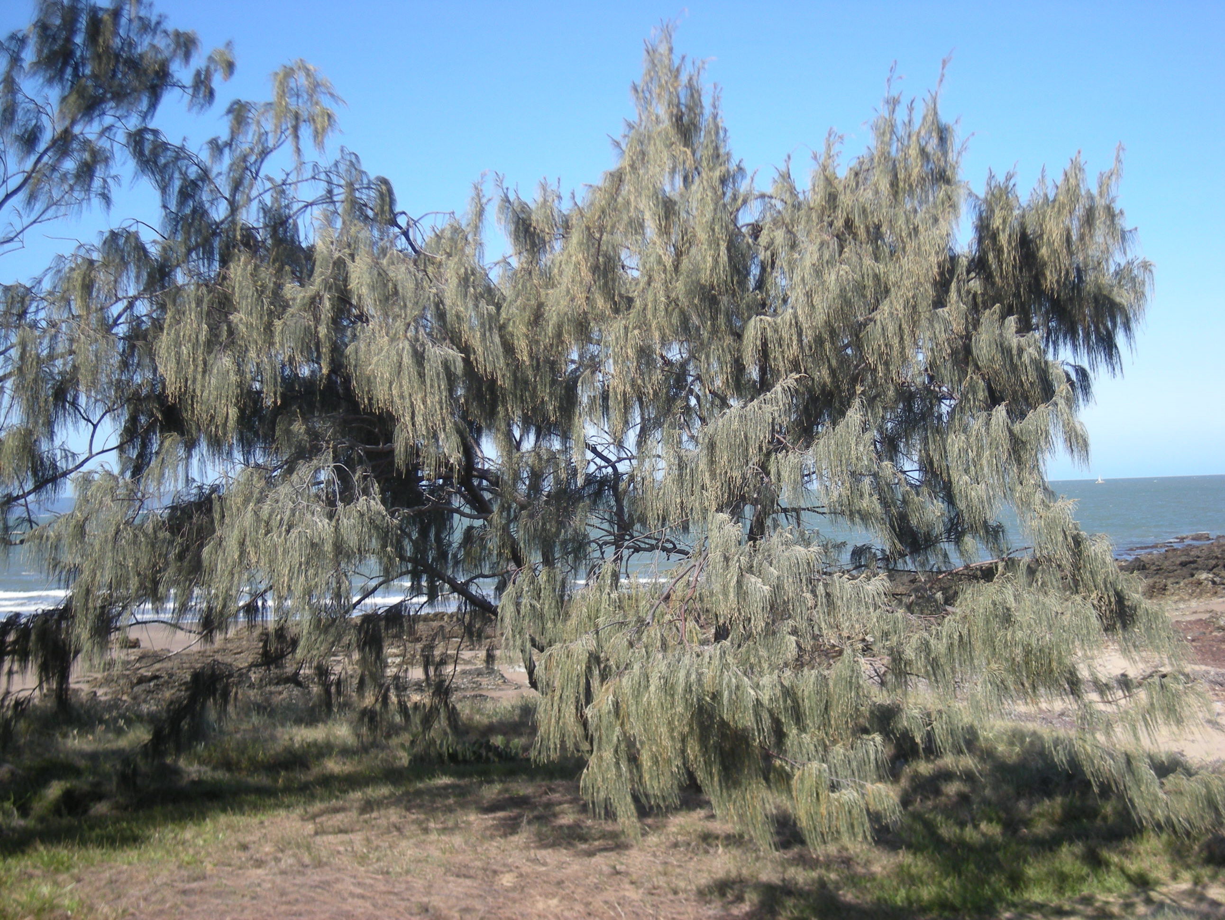
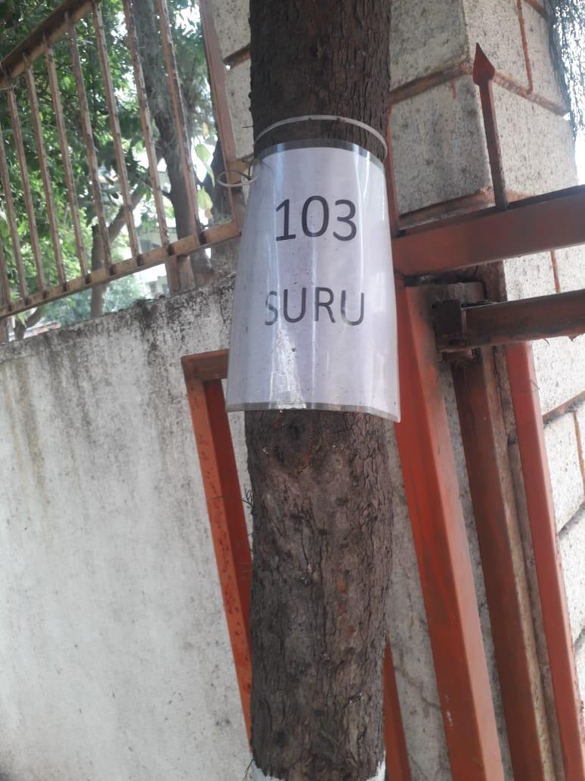
Suru
NEAR MAIN GATE –AIS CAMPUS WAKAD

Slide 2
Common Name : Coastal she-oak
Scientific Name : Casuarina equisetifolia
Family Name : Casuarinaceae
Habit : The Suru tree is a fast-growing, evergreen tree with
a distinctive needle-like foliage and a tall, slender
trunk, commonly found in coastal regions and sandy
soils.
Distribution : The Suru tree is widely distributed across tropical
and subtropical coastal regions of Asia, Australia,
and the Pacific Islands.

Slide 3
Description
The Suru tree is an evergreen tree characterized by its slender, columnar trunk and unique needle-like foliage.
Its small, inconspicuous flowers are followed by woody, cone-like fruit.
The tree has a rugged bark and a deep, extensive root system, making it well-suited to coastal and sandy environments.

Slide 4
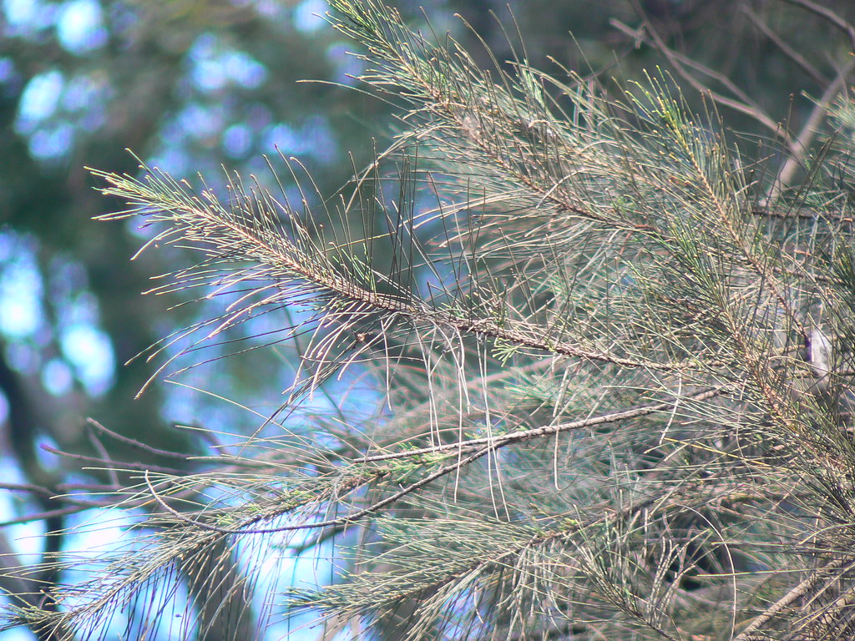
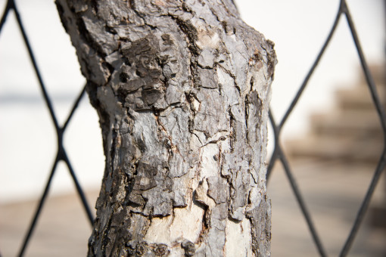
Uses

Slide 5
Erosion Control: Its extensive root system stabilizes soil and prevents
coastal erosion.
Timber: The wood is durable and used for construction, furniture, and
fuel.
Reforestation: It is often planted in reclamation projects to restore
degraded lands.
Environmental Benefits: It helps improve soil fertility by fixing
nitrogen, which benefits surrounding
vegetation.

